Slide 1
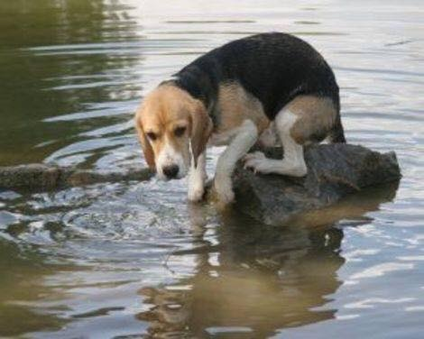
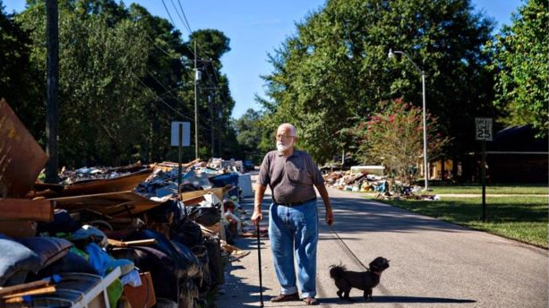
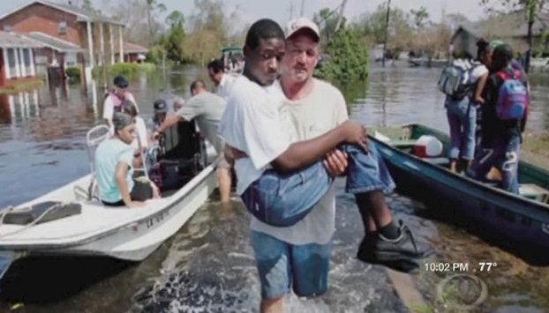
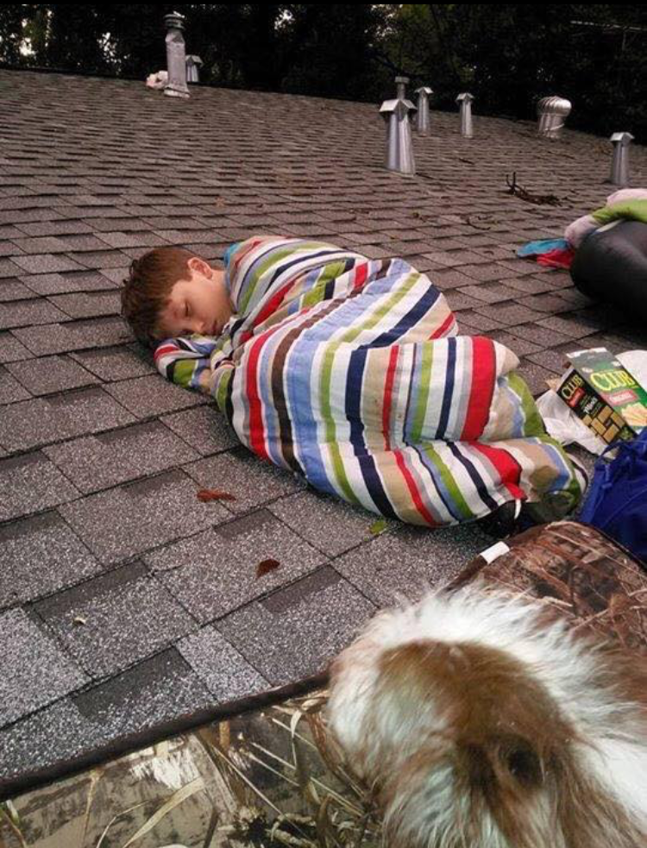
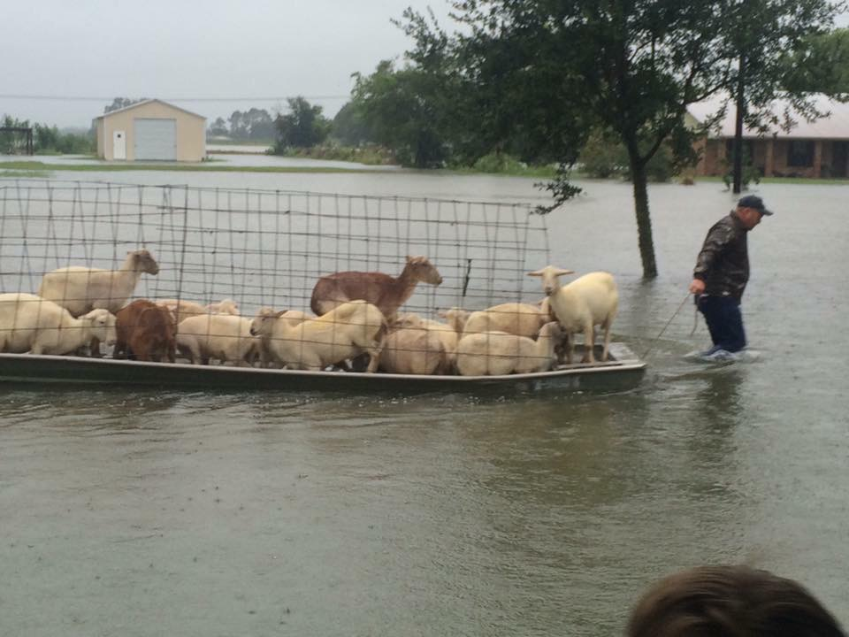
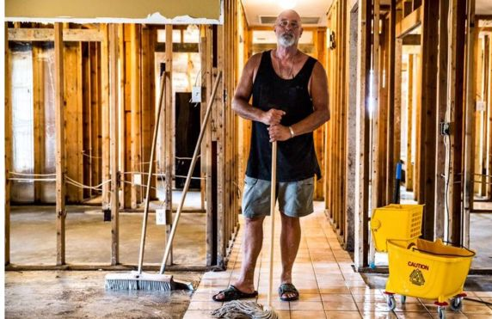
The flood in Louisiana has left 13 dead, over 2,600 people are still in make shift shelters, and over 110,000 homes damaged. 30,000 people were rescued and 3,500 pets were saved. Round Rock High School, with the support of Student Council, has launched a relief effort to help our neighbors. We are collecting the following items to bring to Louisiana on September 2nd. Drop off locations at RRHS are the 1200 Main Office, room 704, and room 126. THANK YOU FOR YOUR SUPPORT!!!
MISCELLANEOUS
Bottled Water
Nonperishable food items
School Supplies
Mosquito Repellent
Medicine for athletes foot
Baby formula and food
Baby Wipes
Baby powder
Baby bottles
CLEANING SUPPLIES
Buckets
Bleach
Cleaning Solutions/Detergents
‘Shockwave’ for mold
Mops
Brooms
Paper Towels
Large Garbage Bags
Rubber Gloves
Masks
Scrub Brushes
Scouring Pads
Sponges
Air Freshener
TOILETRIES
Toothbrushes
Toothpaste
Hand Sanitizer
Shampoo & Conditioner (Travel Size)
First Aid Supplies
Paper Towels
Cloth Towels (body and hand towels)
Bar Soap
Hand Soap
Pull-up disposable adult and infant diapers
Feminine Hygiene Supplies (napkins, tampons)
Disposable Razors & Shaving Cream

